Slide 1
The Solo Club
Narrative Strategic Brief
The Solo Club is a purpose-driven movement and community brand with running at the center. It was born from founder Kyle’s lived experience moving through a difficult personal season and discovering the power of community through movement. In that chapter of life, running became more than exercise. It became rhythm, forward motion, connection, and a way to keep going. What emerged from that experience was a brand about growth, belonging, and building what comes next.
At the heart of The Solo Club is a simple but powerful truth: running is a solo sport, and elevating your life is a solo effort, but both are better done with a strong community around you. That tension is what gives the name its meaning. “Solo” does not mean alone. It speaks to ownership, self-direction, independence, and the personal work of becoming. “Club” is the counterbalance. It speaks to belonging, welcome, shared identity, and the reality that while your effort is your own, you do not have to move forward without people beside you. Together, the name captures a modern kind of community for people who are serious about growth but uninterested in status, pretense, or performance as social currency.
Although the brand is rooted in Kyle’s personal story, The Solo Club is not meant to be narrowly defined by any one life circumstance. It should not present itself publicly as a brand about divorce, single parenthood, faith, heartbreak, or any other specific identity marker. Those elements belong in the founding story, not in the outward expression of the brand. The brand itself should remain broad, inclusive, and open. It is for adults in a building season of life. Some may be parents, some may be single, some may be in transition, and some may simply be carrying the full weight and complexity of adulthood. What binds them together is not biography... It is a mindset.
That mindset is defined by perseverance, strength, and joy. Solo Club members are athletically minded, serious about improving themselves, and drawn to the idea that growth can happen in the company of others without competition for status or belonging. They value personal progress. They want to build their future. They are not looking for a scene, a clique, or a place where they need to prove something. In fact, one of the clearest beliefs at the center of this brand is that there is nothing to prove. That belief should shape the identity, the voice, the experience, and the culture.

Slide 2
The Solo Club is about growth. It is not about rebuilding what was lost. It is about building what is next. The emotional engine of the brand is the idea that community can turn motion into growth. That makes the brand more expansive and more hopeful. It allows people who have gone through hard seasons to see themselves in it, without making pain the price of entry. The Solo Club will feel like a place where people can show up as they are, move forward, and belong.
From a brand strategy standpoint, community comes first and apparel comes second. That hierarchy matters. The Solo Club is not trying to become an apparel brand that later adds a community layer. It is building a community that people will want to wear. The apparel is not the deepest product. The apparel is the signal. It functions as a quiet badge of belonging. It should communicate something about the person wearing it without needing to be loud or obvious. When someone wears The Solo Club, it should signal that they are athletically minded, committed to self-improvement, and actively transforming their lives. It should reflect a person who values progress, growth, and identity without status.
That positioning places The Solo Club in a very specific cultural lane. It should not feel like elite running culture. It should not feel like technical race apparel. It should not feel like typical run-club merchandise. It also should not feel like a therapy group, a singles scene, or a social clique. The opportunity here is to create a movement-centered identity brand that runners recognize immediately, but that still feels broader, cooler, and more wearable than a conventional performance brand. It should feel like a lifestyle identity brand with real emotional depth and real social accessibility.
The personality of the brand should be friendly, inclusive, and fun. It should feel casual and playful, but confident. If The Solo Club were a person at the run, it would be a warm host. It would be the presence that makes people feel comfortable right away. It would never be intimidating, exclusive, or self-important. The emotional experience of the brand should be immediate: welcoming, level footing, and fast belonging. A Solo Club run should feel different from a typical run club the moment someone shows up. There should be no hierarchy, no subtle sorting by ability or appearance, and no sense that anyone needs to earn their place. People should feel like immediate friends. The real outcome is not simply that they had a good run. It is that they leave feeling community.
That sense of belonging also needs to extend beyond physical participation. The Solo Club cannot be built in a way that makes attendance the only path to membership. Someone who never joins a group run should still feel fully invited to wear the brand and belong to the community. “Club” should not feel like a closed system with hard edges. It should feel like an open badge of belonging that people can step into from many different places. That openness is central to the identity.
Because of that, the visual identity has an especially important job to do. The Solo Club is a broader movement-and-community brand with running at the center, but running still needs to register quickly. The logo will do much of that work. The identity system should communicate that the brand is rooted in running, while still feeling like a modern lifestyle brand rather than a purely technical athletic company. It needs to feel highly wearable, highly ownable, and strong across hats, shorts, tees, and other everyday items. It should work with clarity in black and white while leaving room for color and personality. Most importantly, the identity should not over-index on struggle or brokenness. The story can carry the emotional origin. The mark should carry the confidence.

Slide 3
Verbally, The Solo Club should sound like an invitation, not a challenge. Its voice should be warm, open, confident, and human. It should be emotionally intelligent without feeling heavy. It should be playful without feeling unserious. It should never drift into preachy, self-help, overly inspirational, or exclusive territory. There is a cool factor to this brand, but it should be cool without cool-kid energy. It should feel like something people want to be part of because it reflects who they are and who they are becoming.
The clearest articulation of that idea so far is this: For the miles between who you were and who you’re becoming. That line captures the emotional tension of the brand in a way that feels elevated, human, and forward-looking. A supporting expression is Built for what’s next. Together, these lines speak to the deeper role of The Solo Club in people’s lives. This is not just a brand for movement. It is a brand for people building their future.
In summary, The Solo Club should be understood as a community-led running lifestyle brand for adults building what comes next. It should feel like a quiet badge of belonging for people who value perseverance, strength, joy, and personal growth. It should communicate running quickly, but through a brand system that feels more like an inclusive, modern club than a traditional performance-first running brand. It should feel premium but approachable, confident but welcoming, emotionally resonant but never heavy. Above all, it should make people feel that they have found a brand, and a community, where they can move forward on their own terms with others beside them.

Slide 4
Brand Overview:
Name: The Solo Club
Tagline: For the miles between who you were and who you’re becoming.
Core brand idea: Running is a solo sport. Elevating your life is a solo effort. But both are better done with a strong community to support you. This is the core paradox of the brand and the meaning inside the name.
What the brand is: A broader movement-and-community brand with running at the center.
This is not just a run club.
This is not just an apparel line.
This is an identity brand and a community. - Community comes first. Apparel comes second.
Brand truth: Adults building life through running and community.
Audience: The Solo Club is for adults in a building season of life. The shared bond is led first by mindset, then enriched by life stage and emotional season.
This audience is adults:
persevering
strong
joyful
athletically minded
serious about improving themselves
drawn to community without status
They may be parents, single parents, or neither. They may be in their 30s, 40s, 50s, or beyond. The brand should not visibly center family status, faith, divorce, or any one life circumstance. It needs to stay inclusive and open.

Slide 5
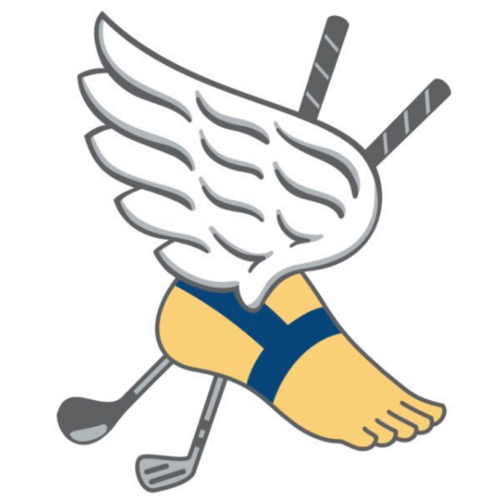
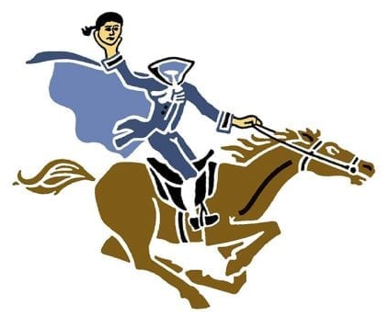


Desired brand feel: Friendly. Inclusive. Fun.
Its personality should be:
casual and playful
confident
welcoming
warm
unpretentious
Identity Vision:
Running shoe that got run over by a truck
With wings, but one is broken and the sole of the shoe is separating from the shoe
Must look good on a hat as well as it does on a pair of shorts
Needs to be simple – looks good in both black and white, but also in full color
No depth – more flat appearing – icon not cartoon character
Not vintage

Slide 6
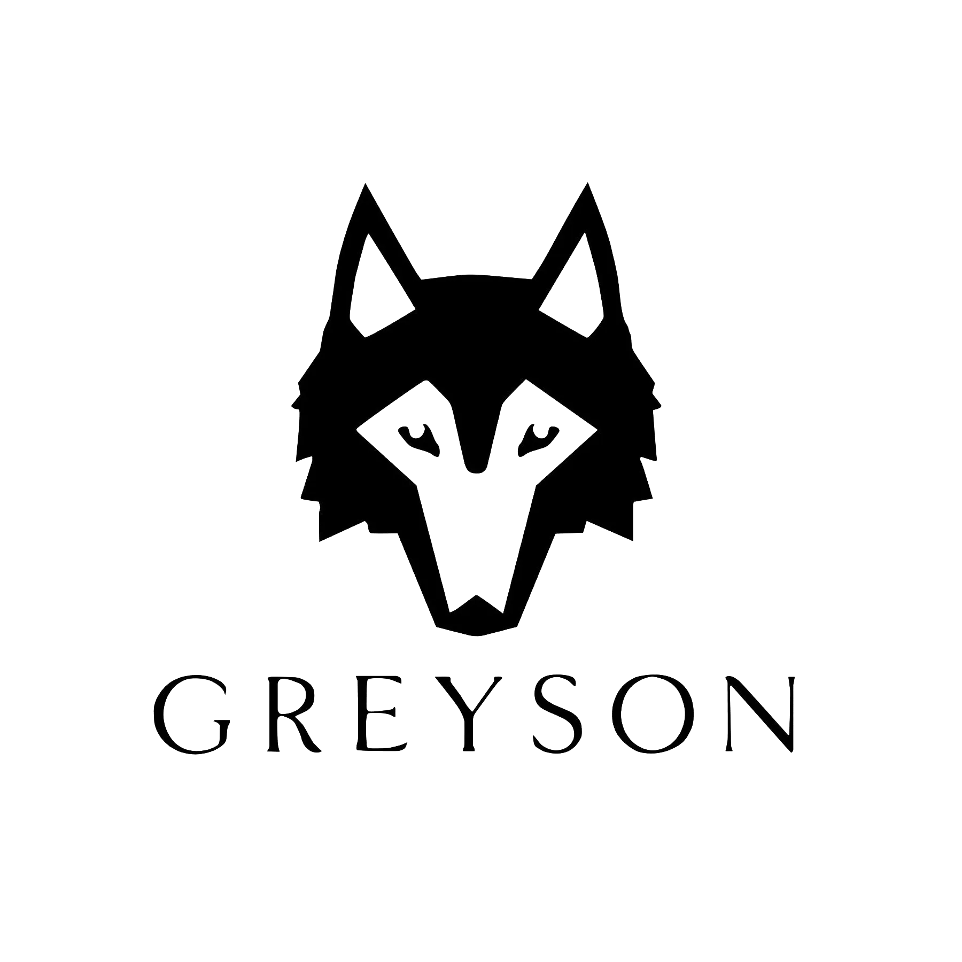
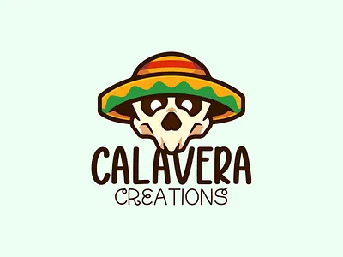



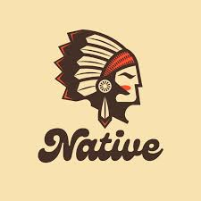


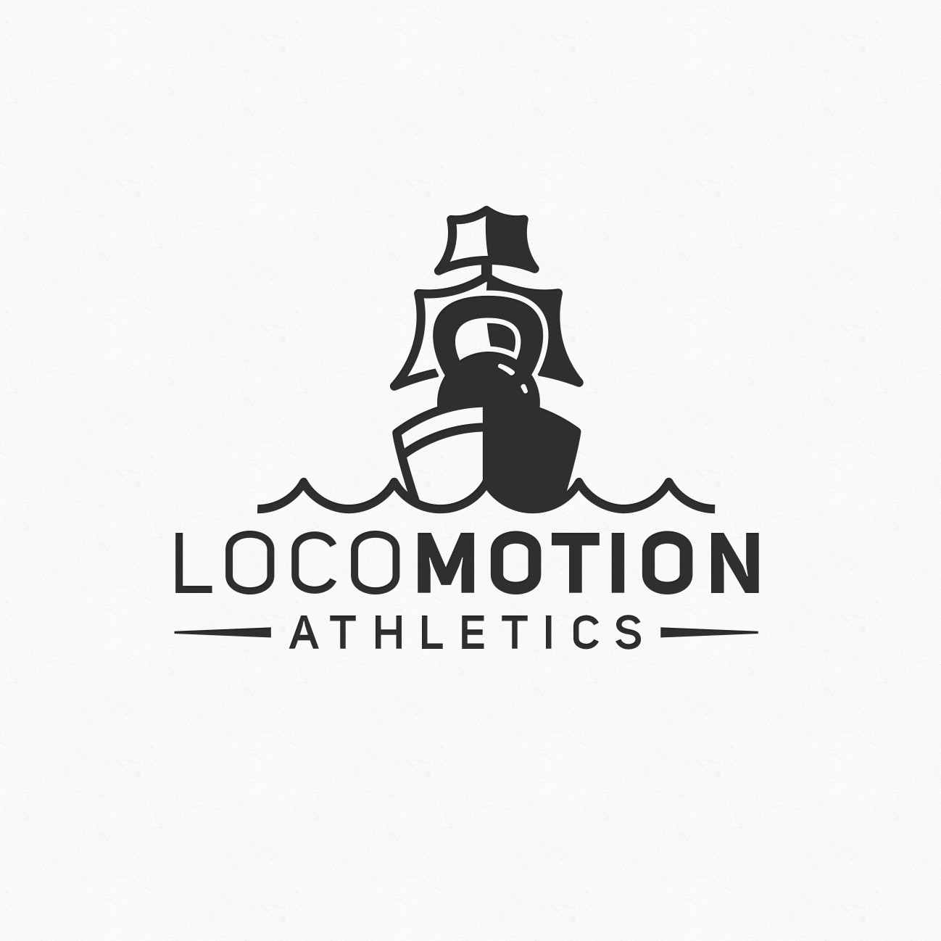
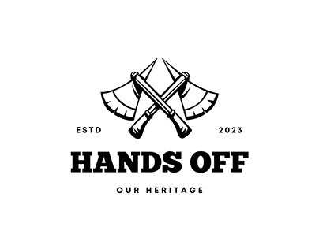
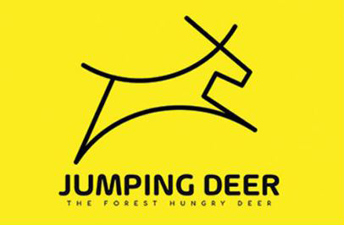
Good might look like

Slide 7
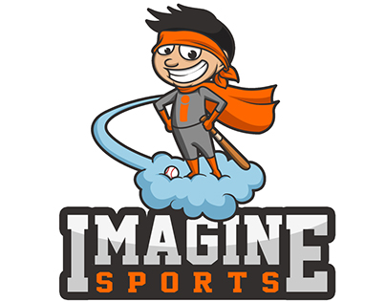
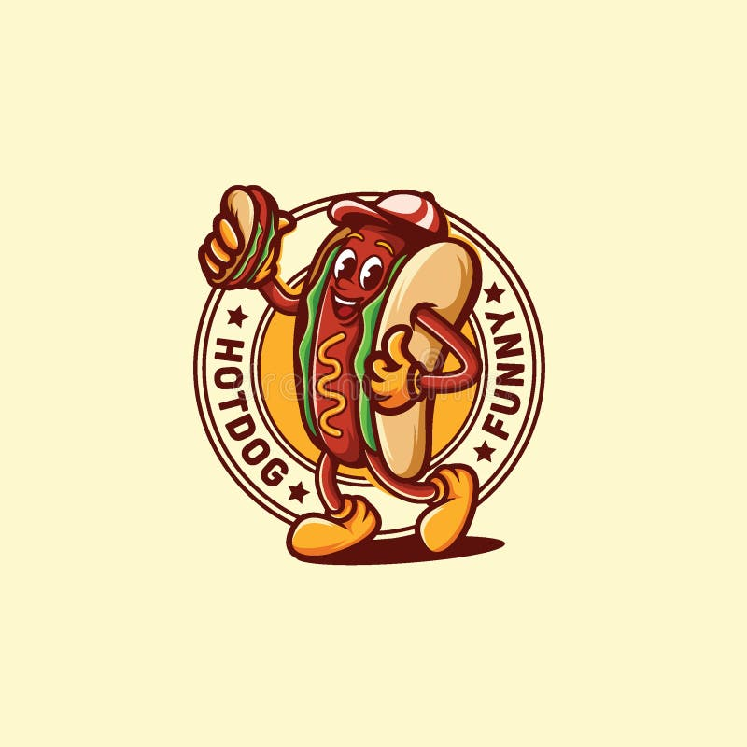
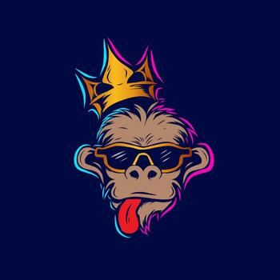
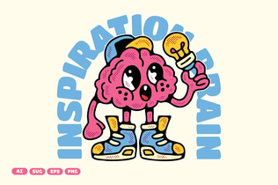

Not like these

Slide 8
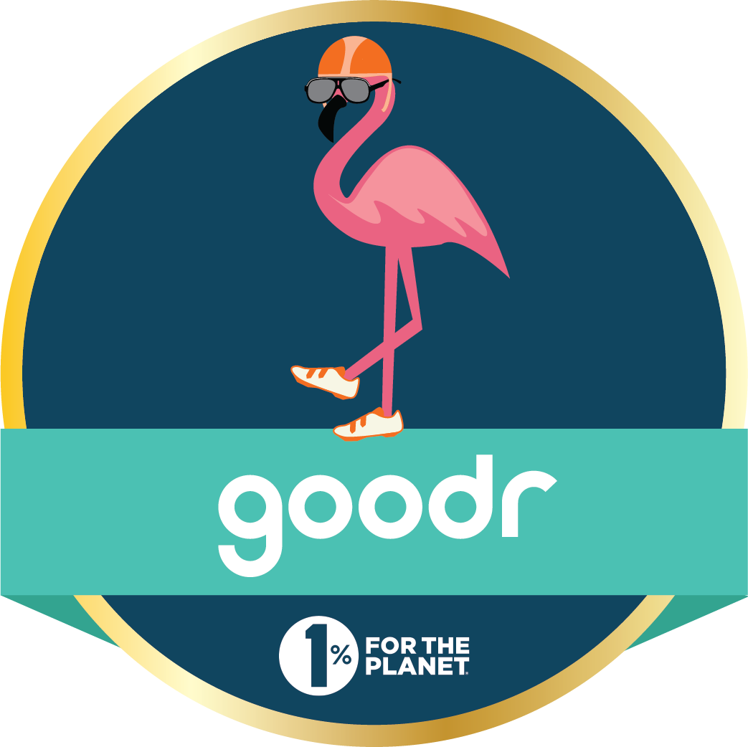
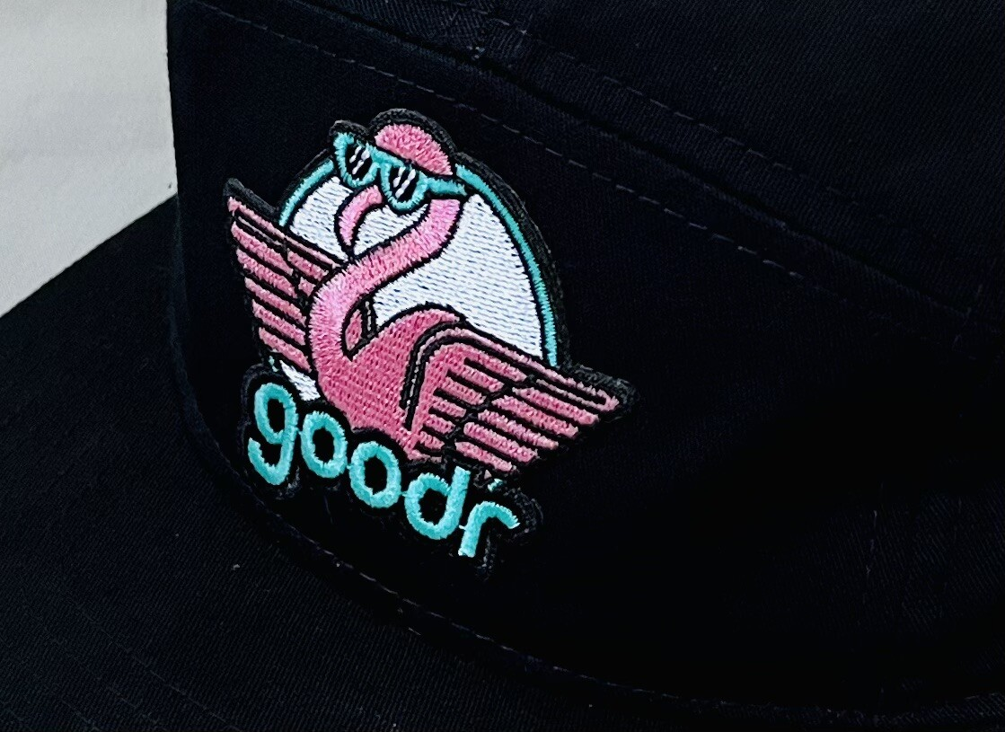


Inspirational brand #1 - goodr
https://goodr.com/

Slide 9
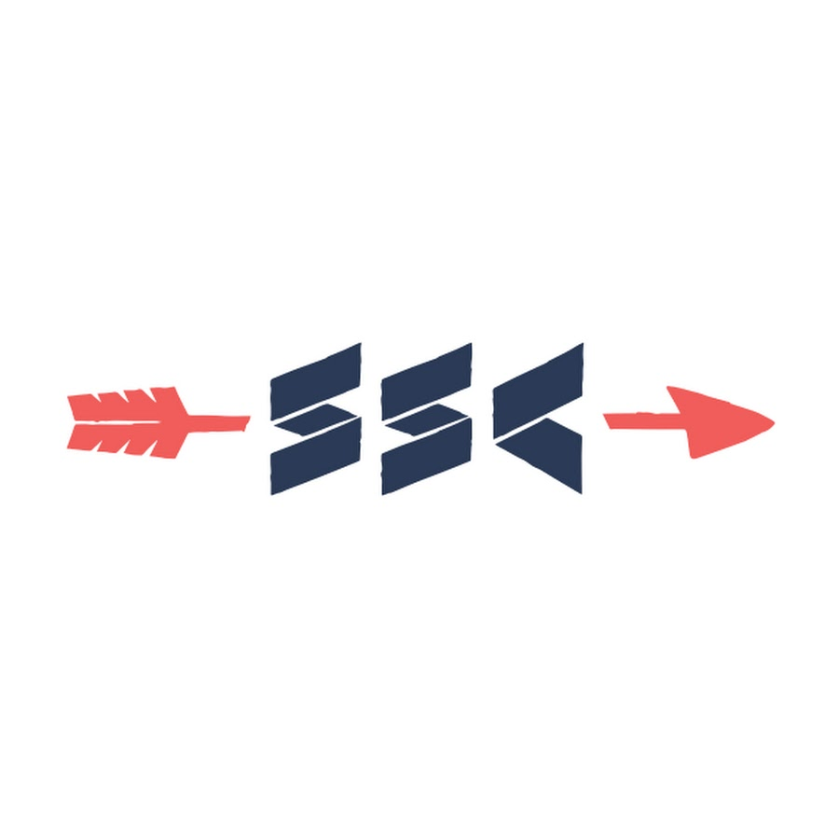
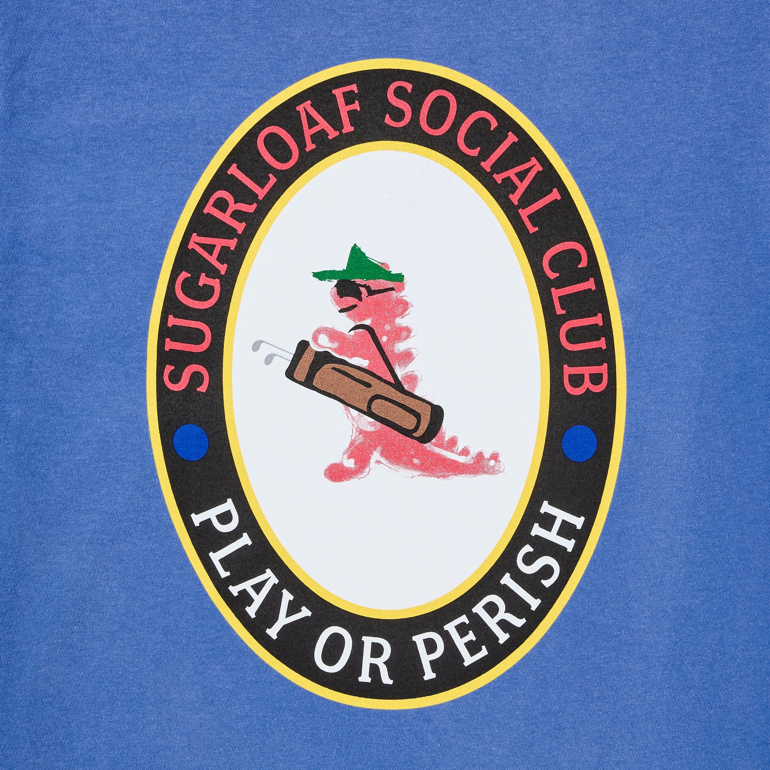

Inspirational brand #2 – Sugar Loaf Social Club
https://www.sugarloafsocialclub.com/

Slide 10
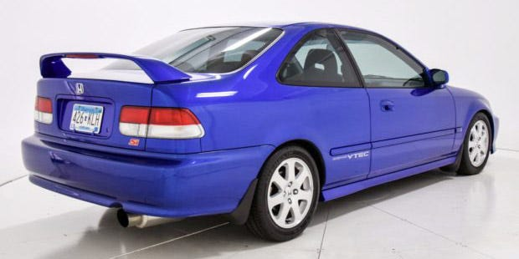
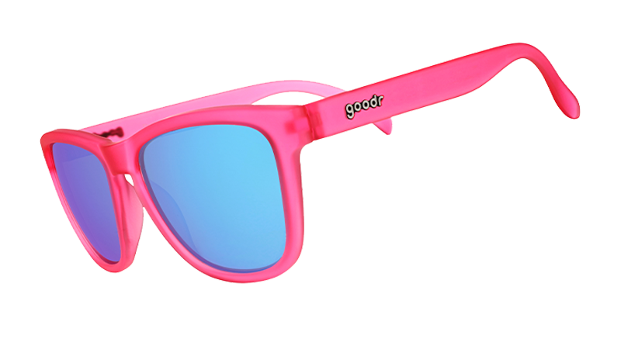
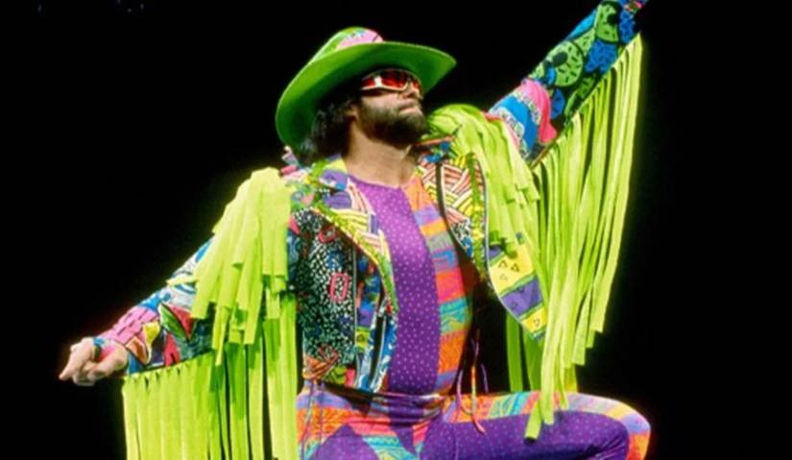
Inspiration colors
Hot pink
Bright deep blue (electron)
Yellow

